Slide 1
Introduction
A design pattern provides a general reusable solution for the common problems that occur in software design. The pattern typically shows relationships and interactions between classes or objects. The idea is to speed up the development process by providing well-tested, proven development/design paradigms. Design patterns are programming language independent strategies for solving a common problem. That means a design pattern represents an idea, not a particular implementation. By using design patterns, you can make your code more flexible, reusable, and maintainable.
It’s not mandatory to always implement design patterns in your project. Design patterns are not meant for project development. Design patterns are meant for common problem-solving. Whenever there is a need, you have to implement a suitable pattern to avoid such problems in the future. To find out which pattern to use, you just have to try to understand the design patterns and their purposes. Only by doing that, you will be able to pick the right one.

Slide 2
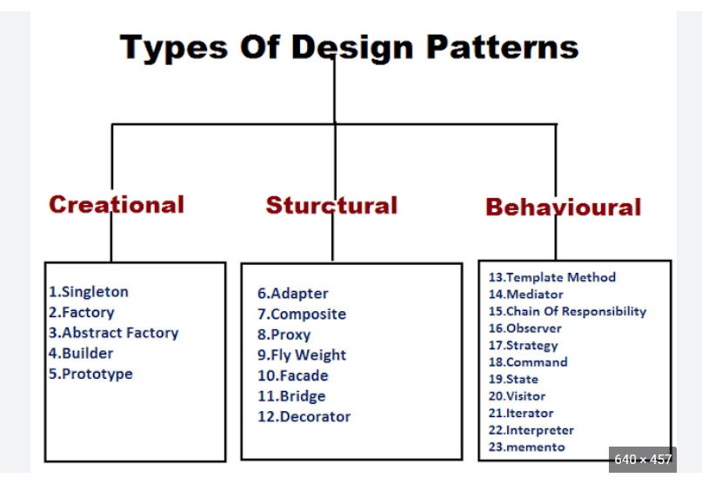
classification-of-design-pattern

Slide 3
Singleton

Slide 4
Facade

Slide 5
Adapter

Slide 6
Bridge

Slide 7
Strategy

Slide 8
Observer

Slide 9
factory vs abstract factory design pattern vs factory method design pattern

Slide 10
MVC
Model: This component stores the application data. It has no knowledge about the interface. The model is responsible for handling the domain logic(real-world business rules) and communication with the database and network layers.
View: It is the UI(User Interface) layer that holds components that are visible on the screen. Moreover, it provides the visualization of the data stored in the Model and offers interaction to the user.
Controller: This component establishes the relationship between the View and the Model. It contains the core application logic and gets informed of the user’s response and updates the Model as per the need.

Slide 11
MVVM
Model: This layer is responsible for the abstraction of the data sources. Model and ViewModel work together to get and save the data.
View: The purpose of this layer is to inform the ViewModel about the user’s action. This layer observes the ViewModel and does not contain any kind of application logic.
ViewModel: It exposes those data streams which are relevant to the View. Moreover, it servers as a link between the Model and the View.

Slide 12
MVP
Model: Layer for storing data. It is responsible for handling the domain logic(real-world business rules) and communication with the database and network layers.
View: UI(User Interface) layer. It provides the visualization of the data and keep a track of the user’s action in order to notify the Presenter.
Presenter: Fetch the data from the model and applies the UI logic to decide what to display. It manages the state of the View and takes actions according to the user’s input notification from the View.
public class Presenter : IPresenter {
public Presenter(IView view) {
...
}
}
public class View : IView
{
private IPresenter _presenter;
public View()
{
_presenter = new Presenter(this);
}
}

Slide 13
MVC vs MVVM
MVC(Model View Controller) | MVVM(Model View ViewModel)
Oldest android app architecture. | Industry-recognized architecture pattern for applications.
User Inputs are handled by the Controller. | The View takes the input from the user and acts as the entry point of the application.
Controller and View exist with the one-to-many relationship. One Controller can select different View based upon required operation. | Multiple View can be mapped with single ViewModel and thus, the one-to-many relationship exists between View and ViewModel.
The View has no knowledge about the Controller. | The View has reference to the ViewModel.
This architecture has high dependency on the Android APIs. | Has low or no dependency on the Android APIs.
Difficult to make changes and modify the app features as the code layers are tightly coupoled. | Easy to make changes in application. Howerver, if data binding logic is too complex, it will be a little harder to debug the application.
Limited support to Unit testing. | Unit testability is highest in this architecture.
It does not follow modular and single responsibility principle. | Follows modular and single responsibility principle.
MVC frameworks:- Ruby on Rails, Django, CherryPy, Spring MVC, Catalyst, Rails, Zend Framework, Fuel PHP, Laravel, Symphony, ASP.net MVC, ASP.net core | mvvm frameworks:- WPF, Angular, Aurelia, Durandal, Ember.js, Ext JS, Knockout.js, Omi.js, Oracle JET, React, Svelte, Vue.js

Slide 14
MVC VS MVP
MVC(Model View Controller) | MVP(Model View Presenter
One of the oldest software architecture | Developed as the second iteration of software architecture which is advance from MVC.
UI(View) and data-access mechanism(Model) are tightly coupled. | The View is loosely coupled to the Model.
Controller and View layer falls in the same activity/fragment | Communication between View-Presenter and Presenter-Model happens via an interface.
User inputs are handled by Controller which instructs the model for further operations. | User inputs are handled by View which instructs the presenter to call appropriate functions.
The many-to-one relationship exists between Controller and View as one Controller can select different View based upon required operations. | The one-to-one relationship exists between Presenter and View as one Presenter class manages one View at a time.
The Controller is the overall in charge as it creates the appropriate View and interacts with the Model according to the user’s request. | The View is the overall in charge in this schema as View call methods of Presenter which further directs Model.
Limited support to Unit Testing | Unit Testing is highly supported.
MVC frameworks:- Ruby on Rails, Django, CherryPy, Spring MVC, Catalyst, Rails, Zend Framework, Fuel PHP, Laravel, Symphony, ASP.net MVC, ASP.net core | MVP frameworks:- ASP.NET Web Application, Windows Forms, Silverlight, JavaFX, AWT, Swing, SWT, PHP

Slide 15
MVVM vs MVP
MVP(Model View Presenter) | MVVM(Model View ViewModel)
It resolves the problem of having a dependent View by using Presenter as a communication channel between Model and View. | This architecture pattern is more event-driven as it uses data binding and thus makes easy separation of core business logic from the View.
The one-to-one relationship exists between the Presenter and the View. | Multiple View can be mapped with single ViewModel.
In this, observables are not needed as a Presenter layer. | In this, observables are needed due to the absence of Presenter layer.
User interface is used more in MVP. | There is no user interface in MVVM.
The architecture is heavyweight. | The architecture is leightweight as compared to MVP.
Testing is done easily as business logic and UI are separate. | Testing is difficult as Business logic and UI are not separate.
In this case, debugging is easy. | In this case, debugging is not easy.
The Presenter has knowledge about the View. | ViewModel has no reference to the View.
Model layer returns the response of the user’s input to the Presenter which forwards it to View. | After performing operations according to the user’s input, the Model layer returns the response to the View.
Presenter handles the application flow and the View is the actual application. | ViewModel is the actual application and View is the interface for the user in order to interact with the app.
The project file will contain more classes as well as code. | The Project file will contain more classes but less code per class.
Maintenance is not ensured in the architecture. | Maintenance of the layers is very good.
Ideal for simple and complex applications. | Not ideal for small-scale projects.
Core testing is not done in MVP | Core testing is done in MVVM.
Easy to carry out Unit testing but a tight bond of View and Presenter can make it slightly difficult. | Unit testability is highest in this architecture.
It does not work well with android applications or software. | It works extremely well with android applications or software.

